Slide 1
Central Utility Plant Community Meeting
October 30, 2024

Slide 2
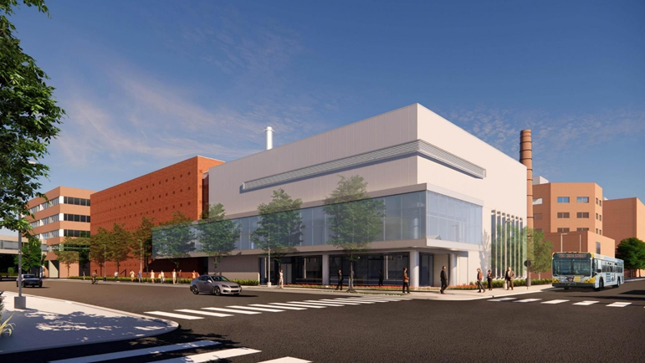
What is the Central Utility Plant?
The new Central Utility Plant (CUP) recently completed construction as part of the Abbott Northwestern Campus revitalization project.
The CUP provides heating, cooling, and emergency and normal power for the Abbott Northwestern Hospital campus, the Children’s Minnesota campus, 910 Medical office building.
The CUP has been operational since May 2024.

Slide 3

Central Utility Plant Sustainability
Replaces 8 1950’s-era boilers with 2 energy-efficient boilers.
Replaces 9 emergency power generators with 3 energy-efficient generators.
Efficient generators = less diesel fuel used in the event of a major emergency.

Slide 4
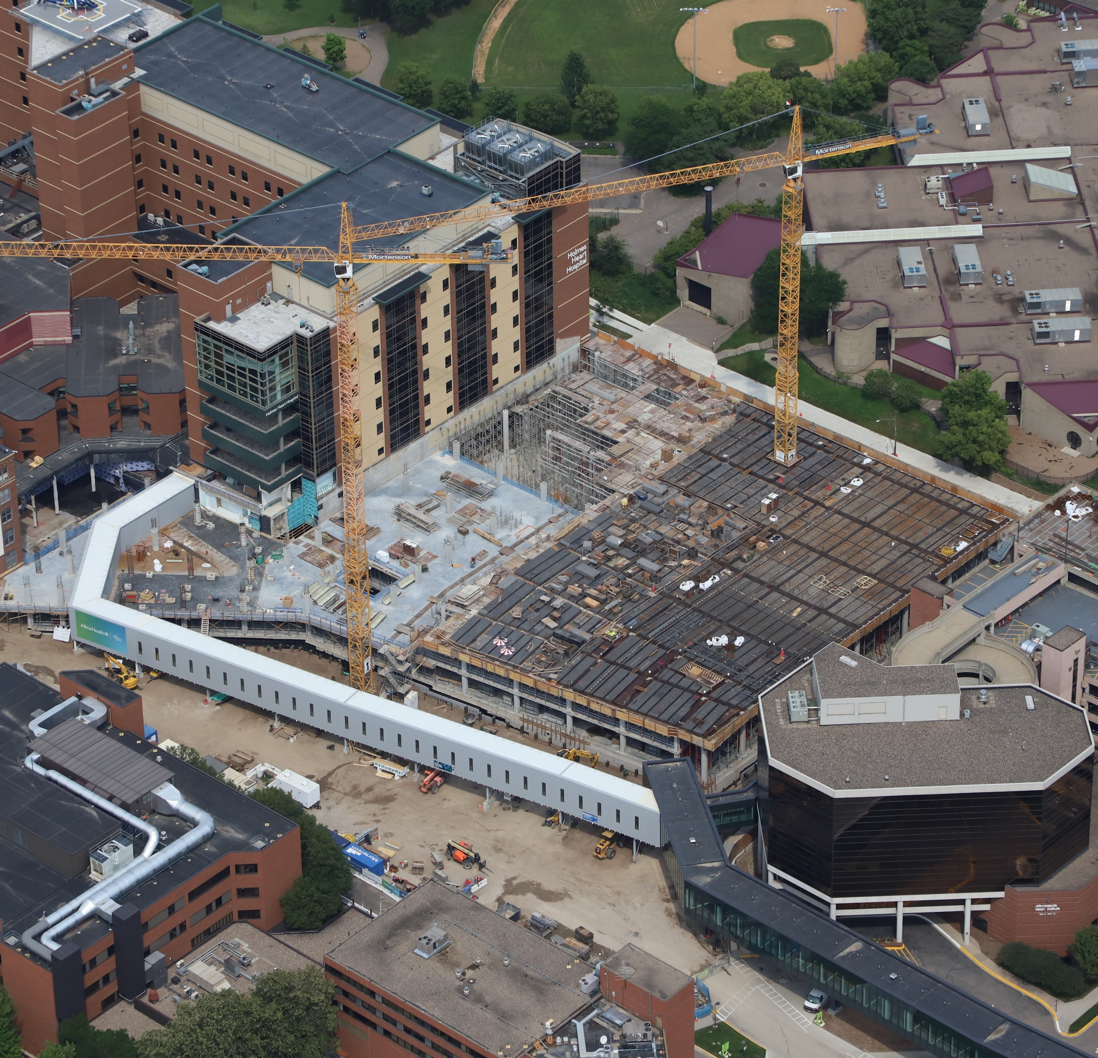
Central Utility Plant Facts
Emissions remain at or below previous levels despite increase in capacity thanks to advanced technology.
The facility features rainwater-capture systems to reduce strain on the local stormwater system.
The CUP lowers our carbon footprint – compared to having separate systems for our individual buildings.

Slide 5
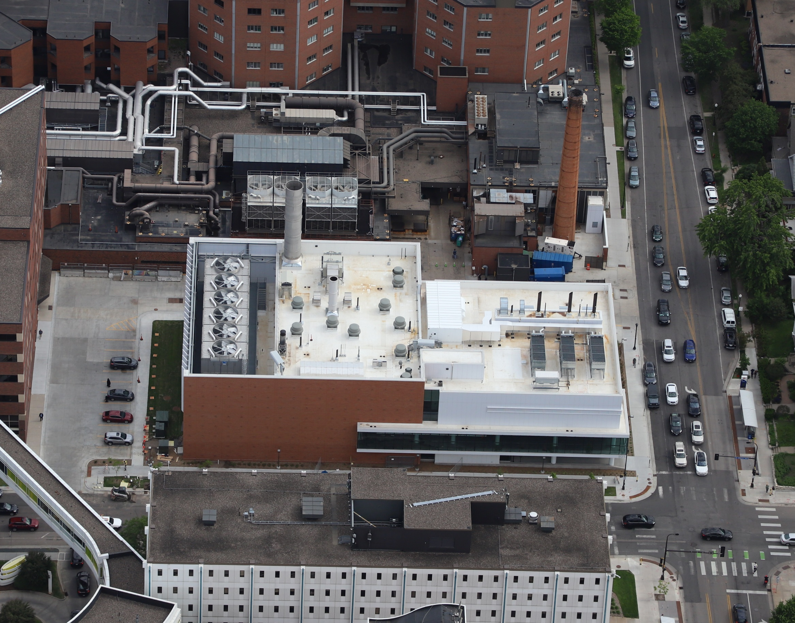
The CUP allows us to have flexibility for our campus to grow and change with the future needs of patients.

Slide 6
Abbott Northwestern Hospital Campus Revitalization Update
Kelly Spratt
Vice President, Hospital Operations

Slide 7
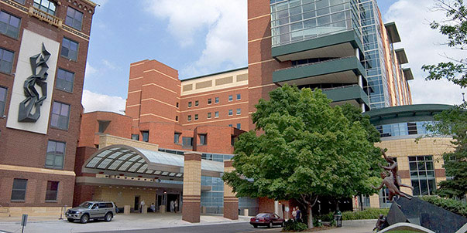






Abbott Northwestern Hospital
Recognized nationally and locally for exceptional expertise and highly specialized care.
Largest private hospital in the Twin Cities, with a 140-year history as an innovator and care provider in the Twin Cities and Upper Midwest. Licensed for 972 beds.
5,796 Allina Health employees and
1,653 non-employed providers.
More than 200,000 patients and their families are served annually.

Slide 8
Abbott Northwestern Role today and in the future
ANW Complex Care Coordinator Role
ANW Quaternary Capabilities
Transplant
Extracorporeal Membrane Oxygenation (ECMO)
Fetal surgery, OB ICU
Sub-specialization within Cancer, Cardiovascular, Neurosciences
Complex Surgical and Procedural Interventions
Education and Research
ANW serves the entire Allina Network
Accommodate High Acuity Transfers
Quaternary Center for Allina
Optimize the investment for high complexity services
Manage Total Cost of Care across entire care continuum

Slide 9
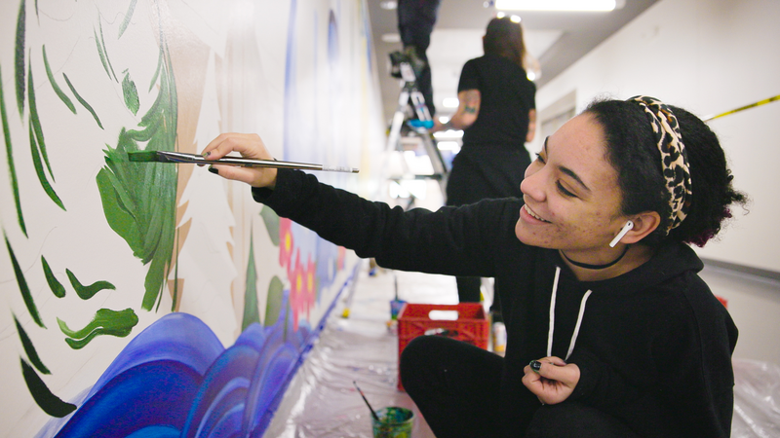
SERVING the needs of our COMMUNITY
ANW is committed to serving the needs of residents in the surrounding neighborhoods
Both Phillips and Powderhorn neighborhoods are younger, more racially diverse, lower income, and speak more languages than the rest of ANW Primary Service Area
Surrounding neighborhoods are medically underserved and have multiple social determinants of health (SDOH) risk factors and barriers to attaining healthy outcomes

Slide 10
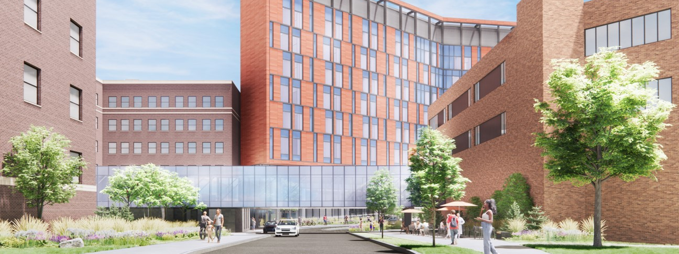
Abbott Northwestern Hospital
Vision: To create a sustainable campus for the future that will support advances in health care delivery, meet the needs of our best-in-class workforce and enhance our value to the communities we serve.

Slide 11
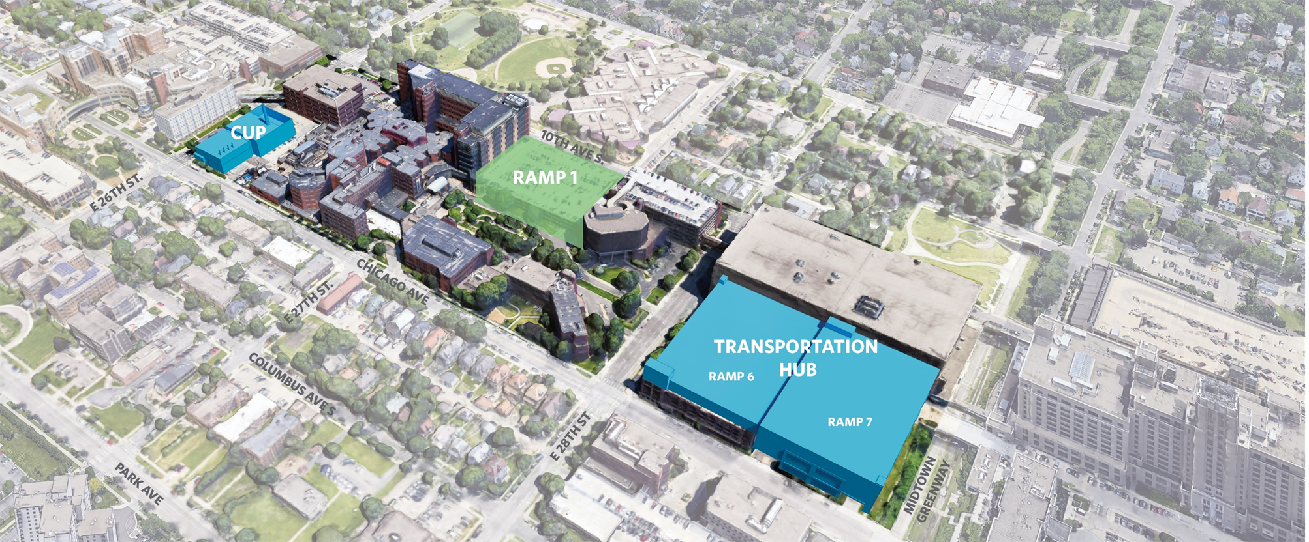

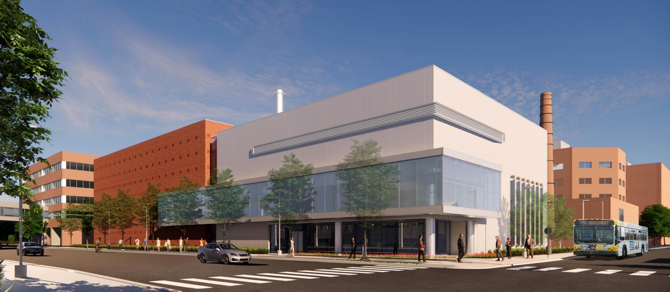
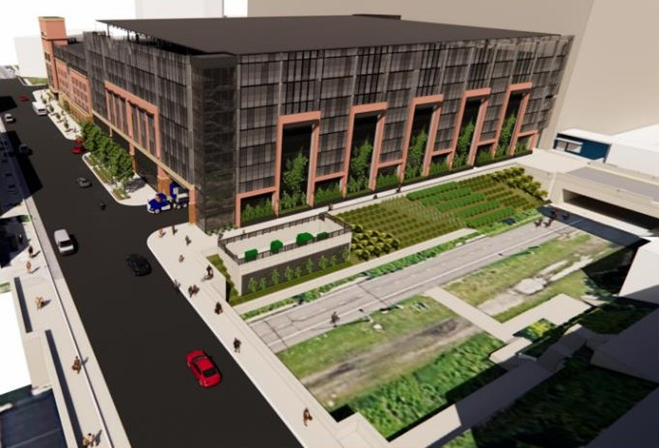
Campus Revitalization Projects
10th
Tower 2026
26th
28th
2024
MacMillan Center 2022
MIDTOWN
EXCHANGE
2022
Chicago

Slide 12
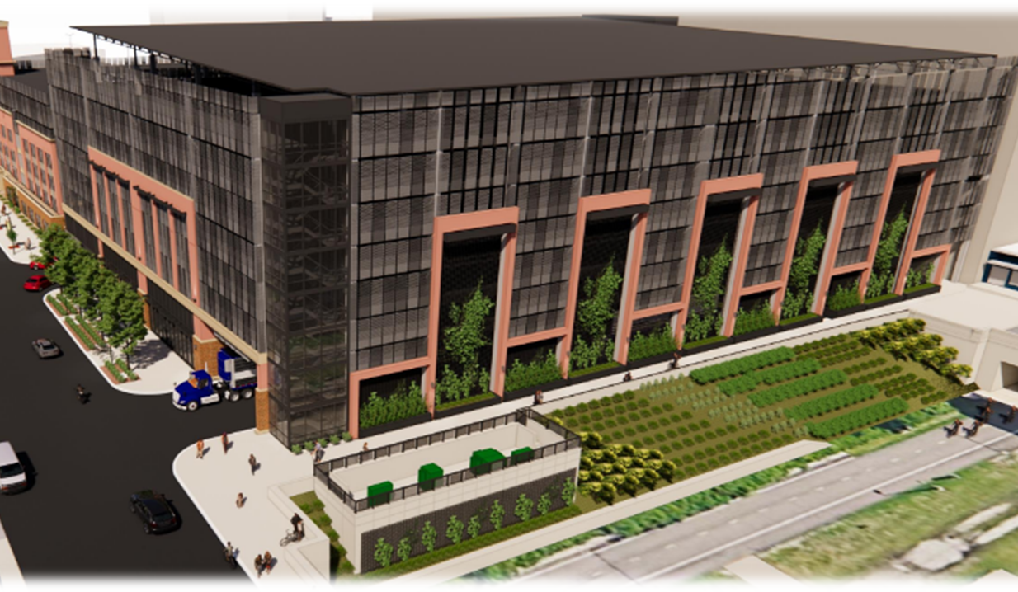
Transportation HUB
  Fall 2022 completion allowed demolition of main ANW ramp
  Rooftop solar panels create a 1MW community solar garden in partnership with Cooperative Energy Futures
  Security Center on Chicago Ave
  20 electric vehicle charging stations
  Expanded bike storage and locker rooms for staff (200)
  Venture Bikes Shop
  Landscaping and lighted walkway
  ​

Slide 13
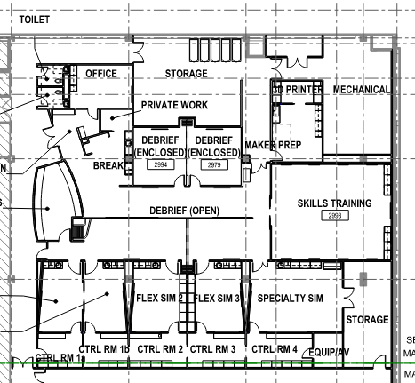
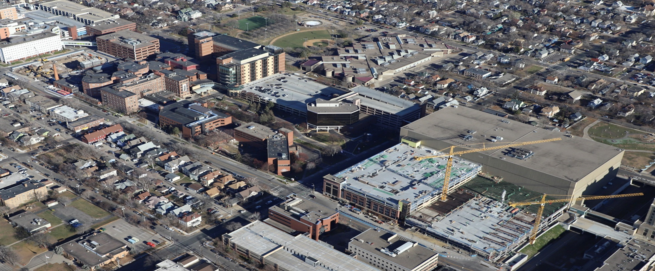
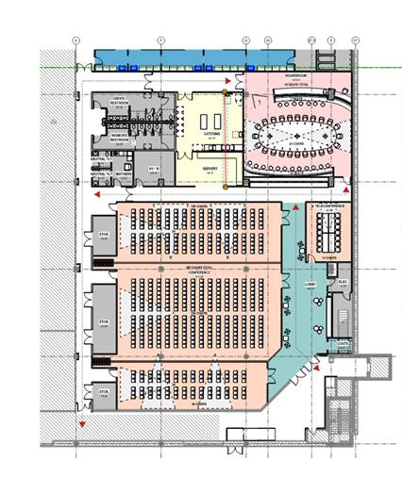
MacMillan Center
  Opened on 2nd floor TAF Skyway in 2023
  Sundet Hall: Conference space with capacity for up to 500 people
  New boardroom
  Vanderboom Simulation Center: State of the art simulation lab with ability to house multiple trainings at once
  Adjacent to new parking for easy access
  Community access / programming
  100% funded by philanthropy
10th Avenue
Greenway
Central Lab
Existing Skyway
Parking

Slide 14
Incorporating Human-centered design principles
Welcoming and empowered
Culturally responsive regional identity
Safety and activation
Foster well-being
Seamless and supported experience
Community
Care
Patient
Staff

Slide 15
Welcoming, open, safe, seamless

Slide 16
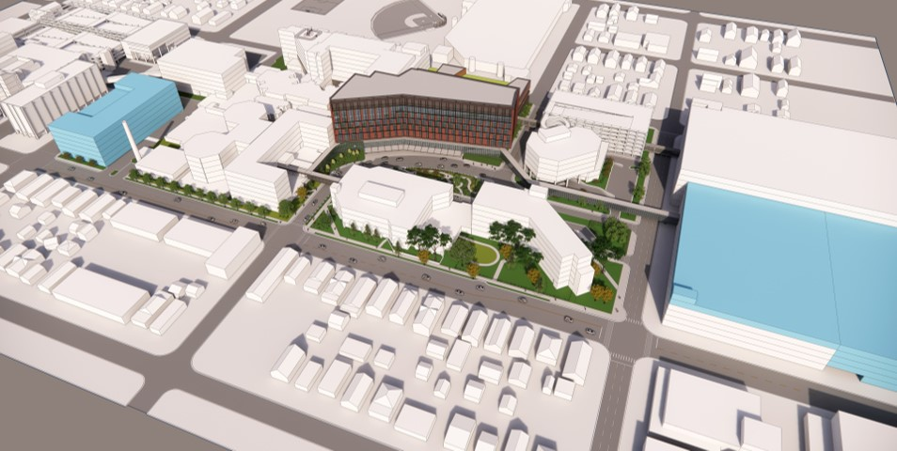
2026: The Future of Health Care

Slide 17
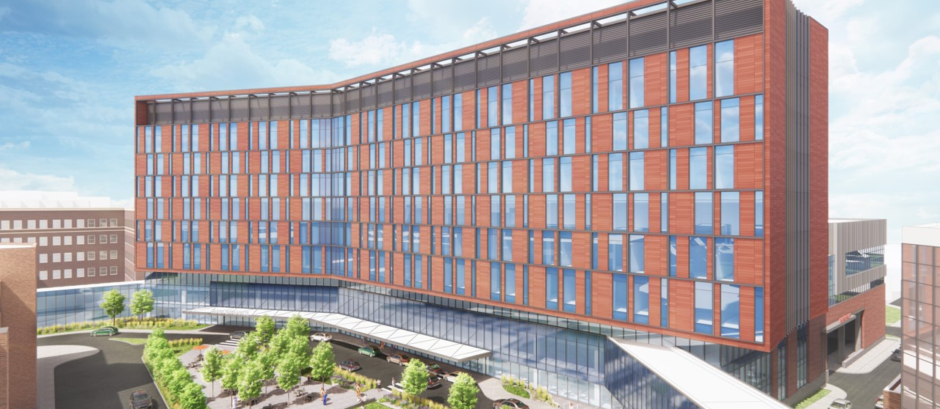
View from the west

Slide 18
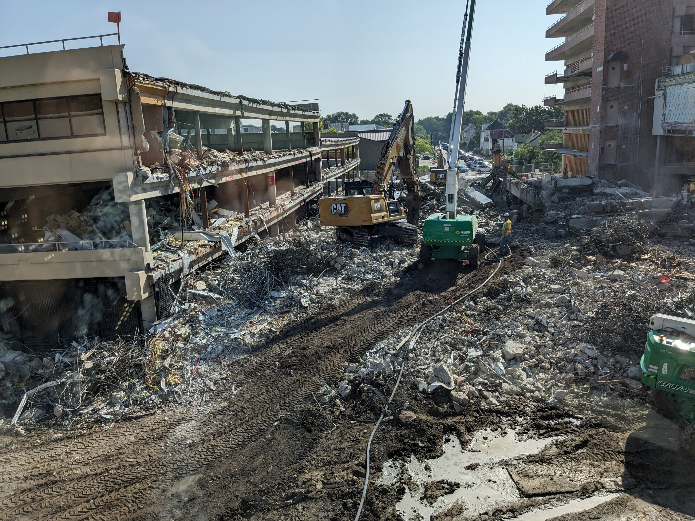

Next generation of Abbott Northwestern Hospital
Mortenson Construction is a long-time partner to Allina Health. Mortenson is committed to the development of a diverse construction workforce. As our partner in building the new surgical and critical care building on our campus, Mortenson is working to ensure those who live and work in our community have the opportunity to participate in and benefit from this project. The company’s Community Workforce Program (CWP) aims to expose local residents, women, and people of color to the construction industry through construction craft worker employment opportunities.

Slide 19
Sustainability at Allina Health
Suzanne Savanick Hansen
Sustainability Manager

Slide 20
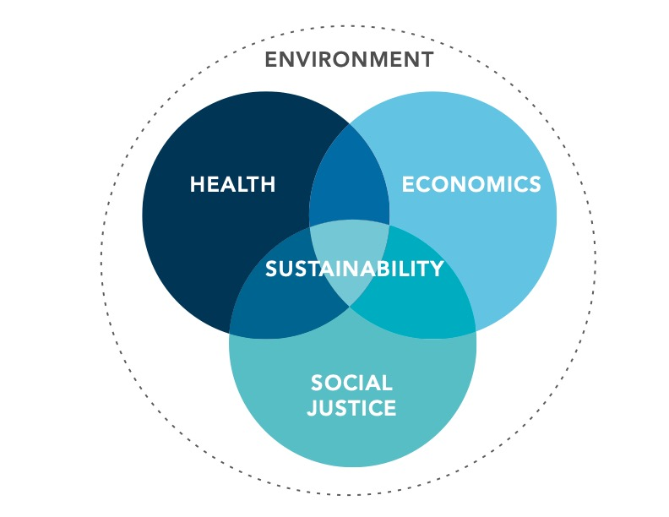
What is Sustainability?
Health care’s opportunity
Mitigate health care’s impacts
Mitigate direct environmental and public-health footprint.
Create community health and resilience
Partner with communities to build health, wealth and resilience at individual, community and global scales.
Lead broader societal transformation
Advocate for policies that are more protective of both human health and the ecosystems that sustain all life.
Notes:
The left side is the diagram of sustainability that we are using here at Allina Health. The right is the overview of why we do this work in health care.

Slide 21
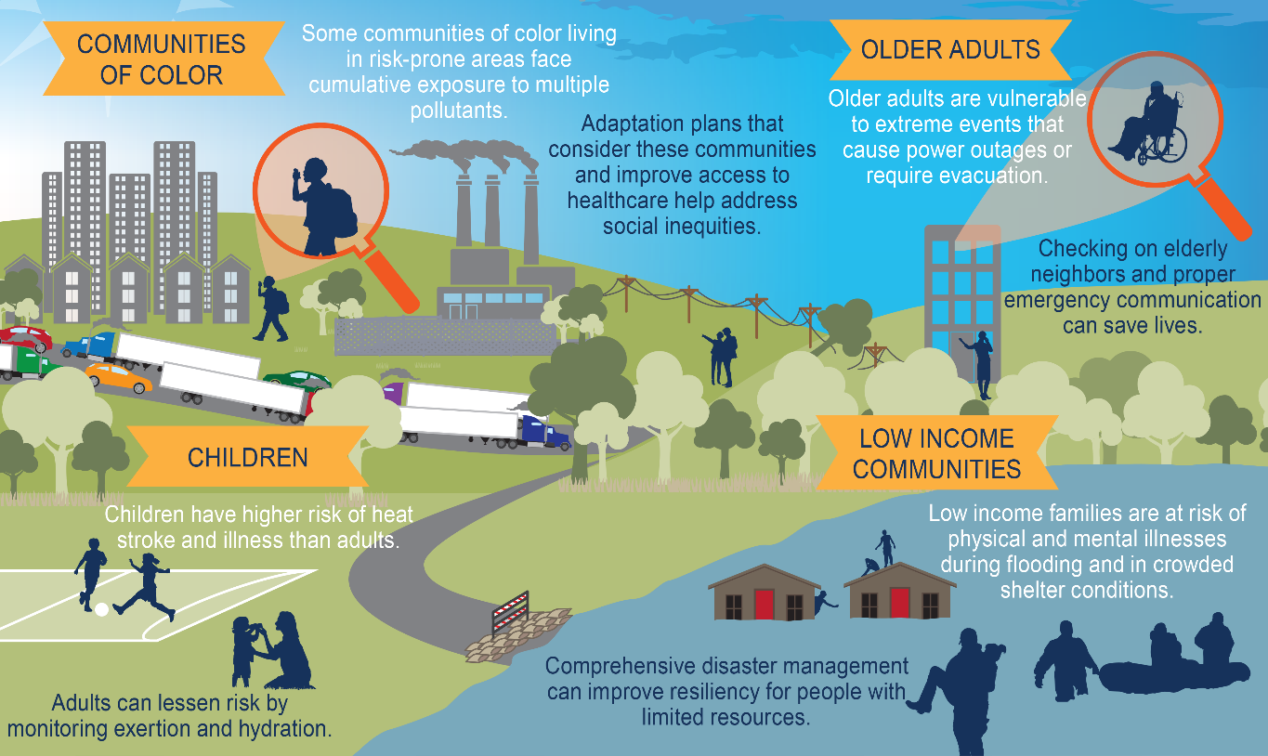
Why Sustainability?
Taking care of our environment is critical to ensure good health for patients, employees and community.
Vulnerable Populations
Health care’s climate footprint
U.S. Health care is responsible for 12% of GHG
Health impacts of Climate Change
Severe weather – Extreme Heat
Pollution – Flooding – Vector ecology
Astha, cardiovascular disease, injuries, mental health, Lyme disease, malaria
Image source: New England Journal of Medicine
Data sources: Health Care Without Harm, National Library of Medicine
Source: https://www.apha.org/Topics-and-Issues/Climate-Change/JEDI/Part-1/Health-Impacts-of-Climate-Change
Notes:
US Healthcare responsible for 12% of GHG.
The health impact of pollutants from the health care sector is proportionate (equal in measure or corresponds in amount) to deaths from (the health impacts of) preventable medical errors. Environmental Impacts of the U.S. Health Care System and Effects on Public Health - PMC (nih.gov)

Slide 22





Sustainability Accomplishments
Reducing energy
Energy efficiency projects save over $1 million every year in avoided utility costs.
Reducing waste
Food waste to hogs program at five of our hospitals saved 290 tons of food waste from incinerators and landfills in 2022.
All copy paper is now 30% recycled content across our system.
Supporting pollinators
Honey from a honeybee hive at Courage Kenny Golden Valley is used in the site cafeteria.
Native plants at the new purple ramp will reduce stormwater runoff and provide pollinator habitat.
Designing environmentally friendly buildings
Certifying all of our major new construction to Leadership in Energy and Environmental Design, commonly known as LEED, standards starting with our new buildings at Cambridge and Abbott Northwestern.
Our pledge to join The Health Care Climate Challenge strengthens our commitment to protect our communities.
We are very excited to share that we are planning to reduce our greenhouse gas emissions by 50% by 2030 and 100% by 2050.
We plan to accomplish this by focusing on energy efficiency, renewable energy, working with our suppliers and reducing waste.
Notes:
Leader collaborative

Slide 23
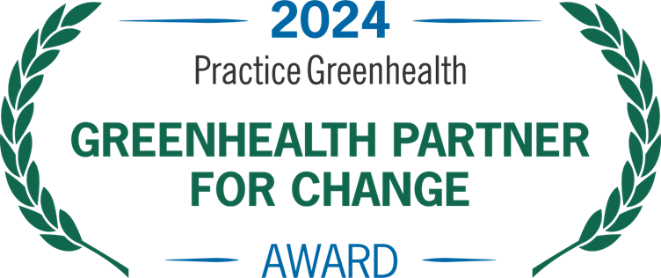

Abbott northwestern sustainability
Practice Greenhealth Partner for Change Hospital three years in a row!
First LEED Certified Green Building Project at Allina Health
Neuroscience Modular wall design (DIRRT)
  12,417 lbs of drywall prevented from landfill
  20 lbs of drywall waste prevented from entering air
  72% recycled content

Slide 24
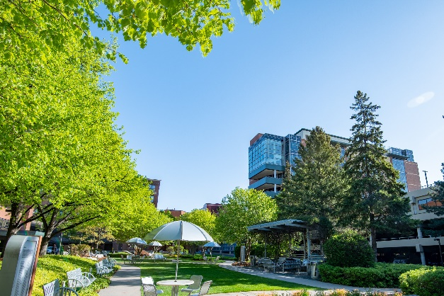
Abbott Northwestern LED Light Grant
  $312,000 grant
  Area with high environmental justice score
  (over 90 percentile)
  Environmental benefit
  80-95% average energy reduction
  Equivalent of the annual electricity used in 75.6 homes
  Estimated societal health benefit
  $896,727 annually
  $9 million over project life
Estimates of savings calculated in GRITS https://app.gogrits.org/. Equivalences estimated from https://www.epa.gov/energy/greenhouse-gas-equivalencies-calculator. Estimated health impacts from Practice Greenhealth Health Effects Calculator. https://www.epa.gov/ejscreen
Notes:
Energy efficiency High EJ Scores (80/90 percentile in state) Bloomington, Lake Street and West St. Paul Clinics
Disproportionate health impact on communities of color
Slide Notes:
All data except mercury related and social cost of carbon came from COBRA: https://www.epa.gov/statelocalenergy/co-benefits-risk-assessment-cobra-health-impacts-screening-and-mapping-tool. All values are in 2017$, assume 2017 income levels and a 3% discount rate.
1.Premature death: average of of two expected premature adult mortality studies and added with premature infant mortality
2.Hospital Admissions: represents the total expected hospitalizations for respiratory and cardiovascular illnesses, excluding heart attack. Respiratory estimate is from the pooled results of five studies that examined different age cohorts and symptoms.
3.Asthma Exacerbation: incidents of cough, shortness of breath, wheeze, or upper respiratory for 6-18 year old only. Adult values are captured in the work loss and restricted days.
4.Respiratory Symptoms: lower respiratory symptoms including acute bronchitis for children only. Adult values are captured in the work loss and restricted days.
5.Non-fatal heart attacks: average of five studies
6.ER visits (asthma): among all ages but does not include asthma exacerbation
7.Mercury related: not captured in the incidents per year but in the values from "Economic Valuation of Human Health Benefits of Controlling Mercury Emissions from U.S. Coal-Fired Power Plants" (2005). Harvard Center for Risk Analysis. This paper provides a high-end range of $182 million/ton (2000$) to $194.5 million/ton (2000$) for annual benefits, in avoided neurotoxicity and cardiovascular illness, of avoided mercury emissions from power plants. We average these values to $188.25 million/ton, and escalate this to 2017$.
8.Social cost of carbon: sourced from https://19january2017snapshot.epa.gov/climatechange/social-cost-carbon_.html.

Slide 25
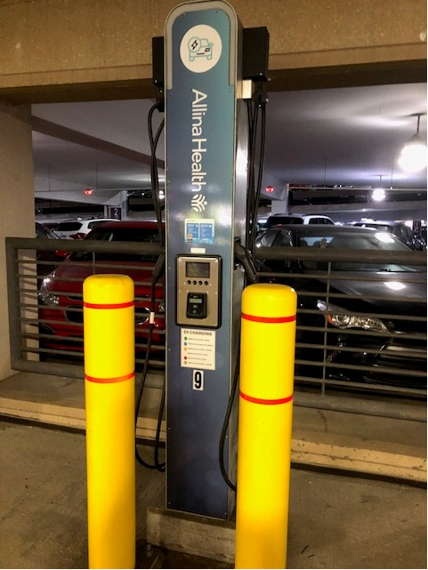
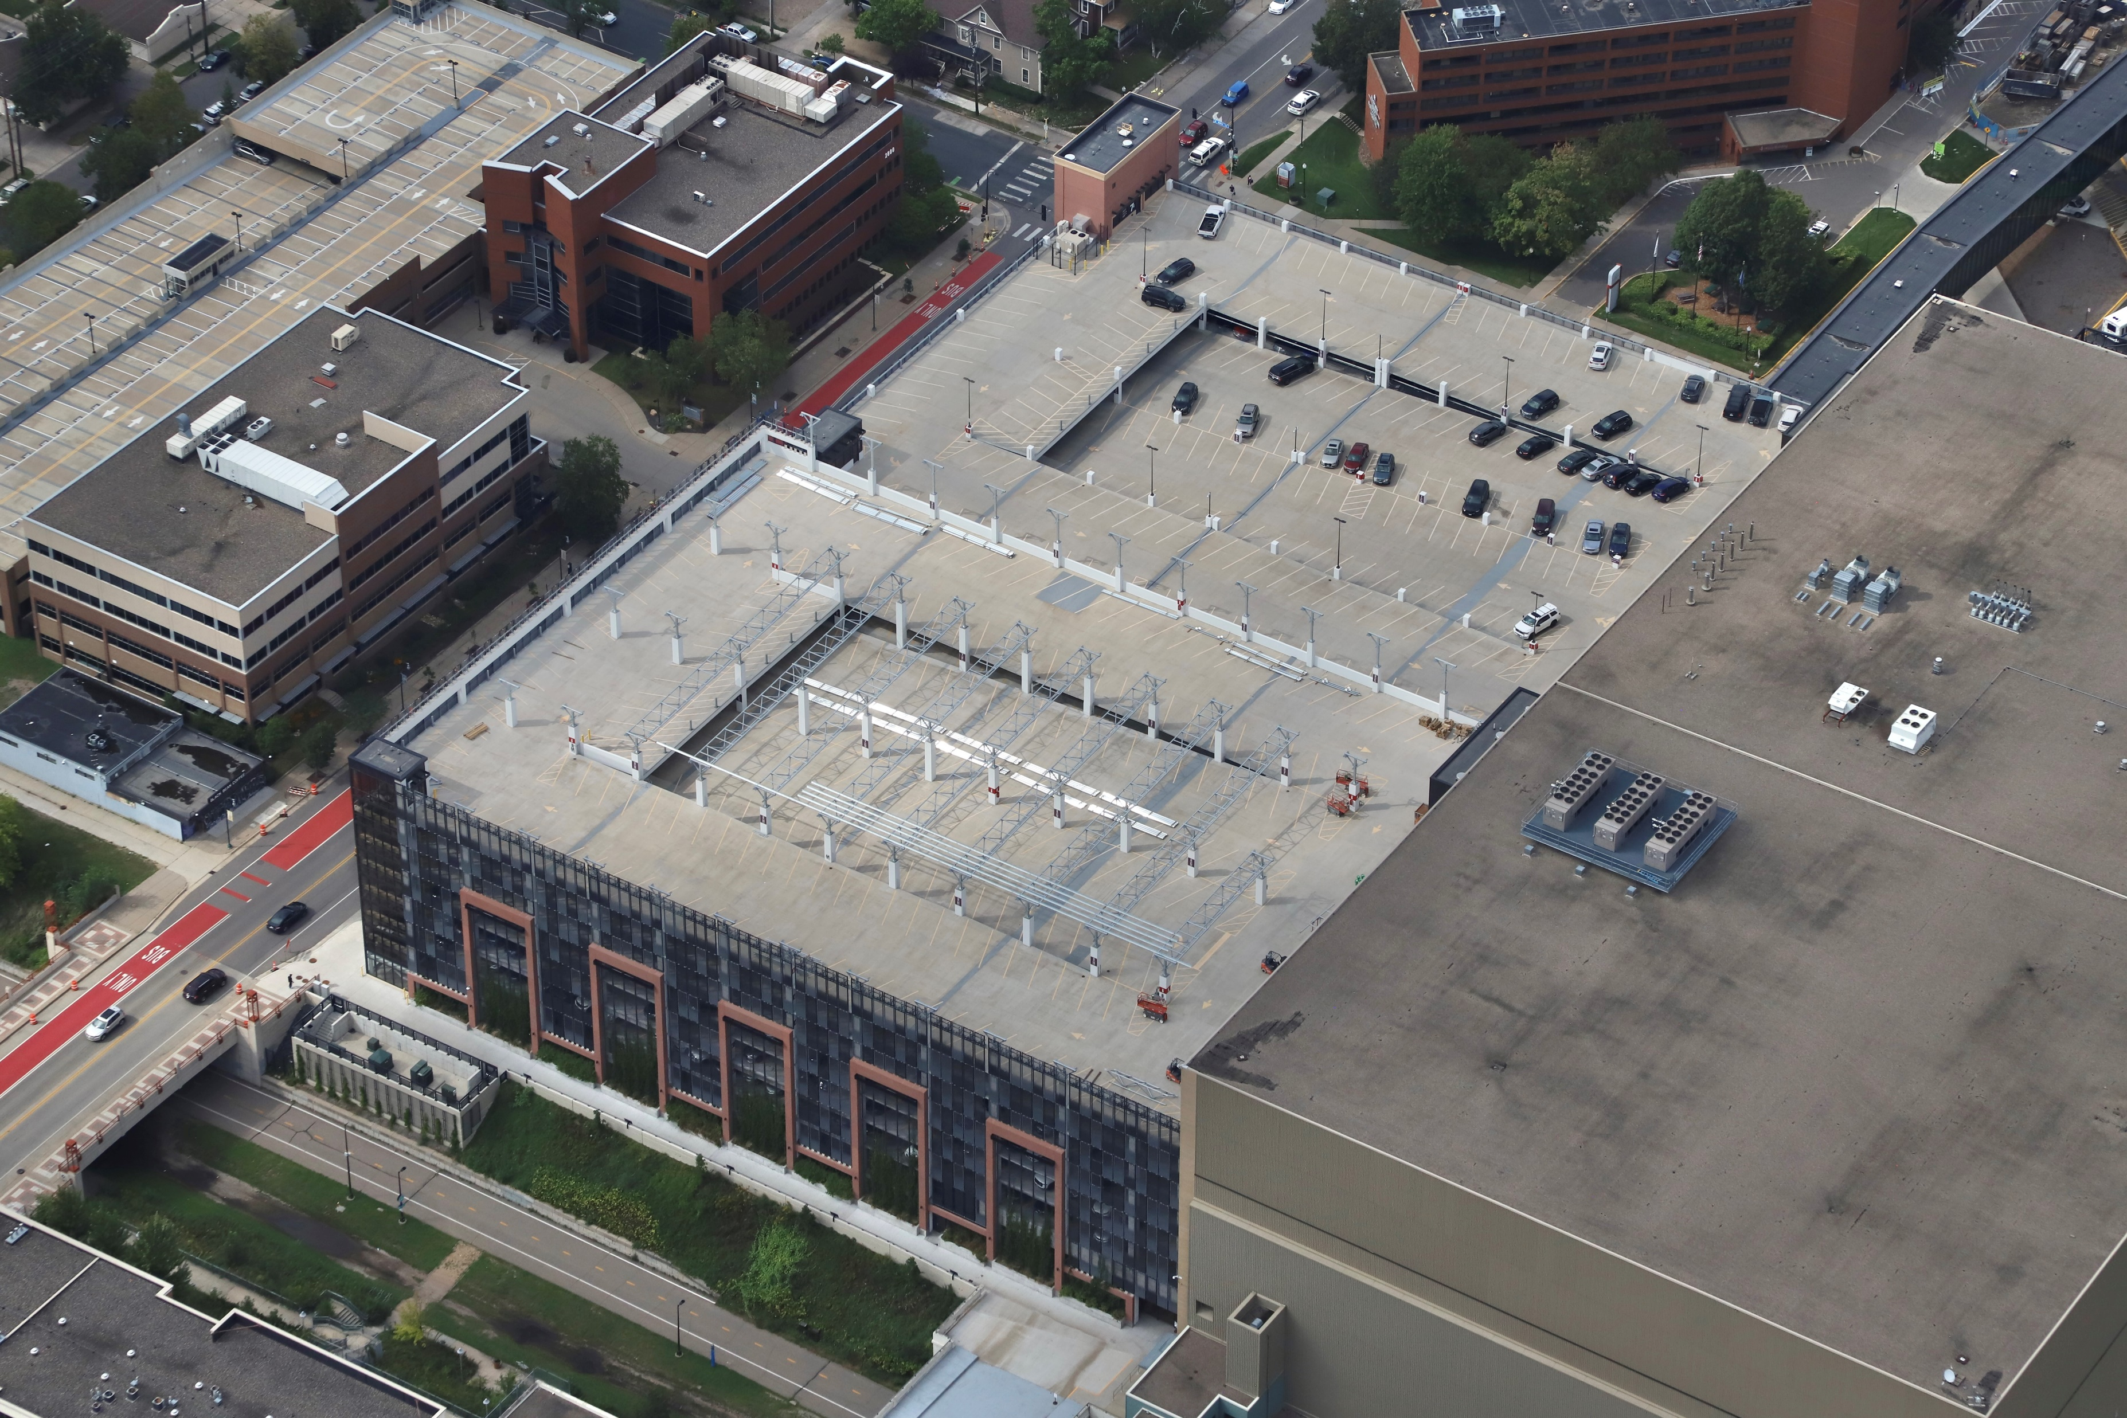
Purple ramp
EV charging stations 20 stalls
Community Solar Garden roof, 1 mega-Watt, provide electricity to ~250 homes
Pollinator/stormwater grant for slope to Midtown Greenway
Notes:
Source image: https://www.power-grid.com/der-grid-edge/minnesota-electric-car-drivers-will-see-22-new-places-to-fast-charge-this-fall/#gref

Slide 26
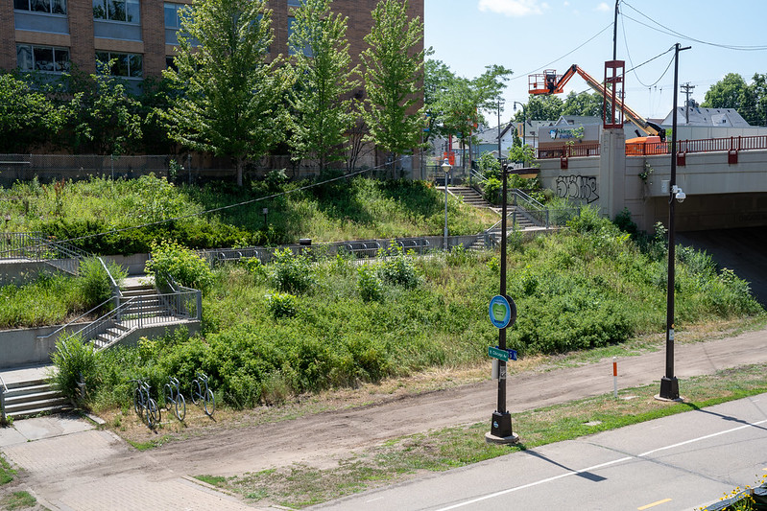
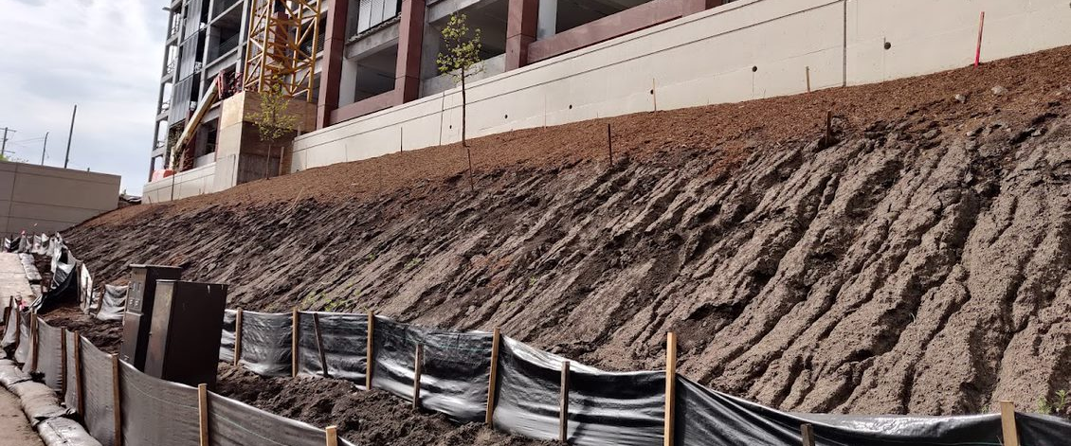
Pollinator Slope:
Before

Slide 27
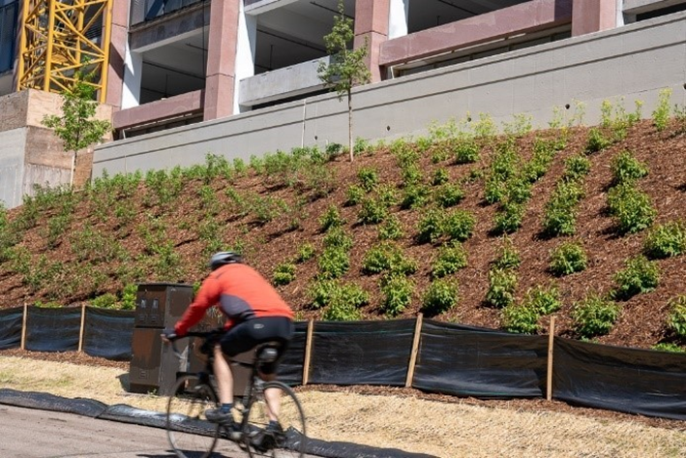
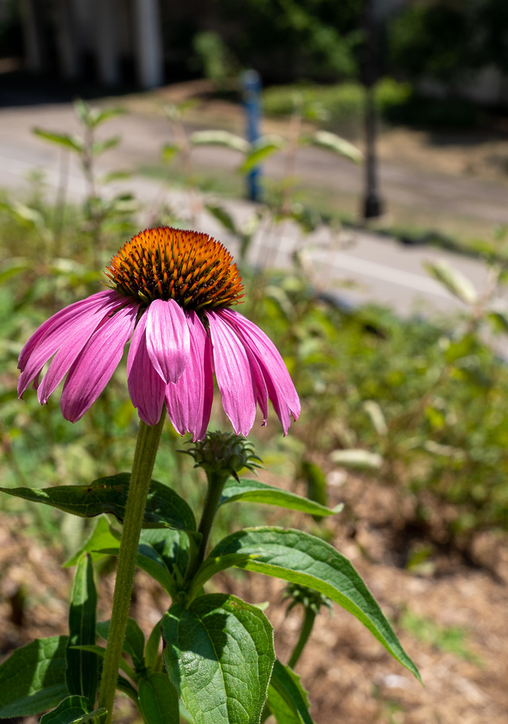
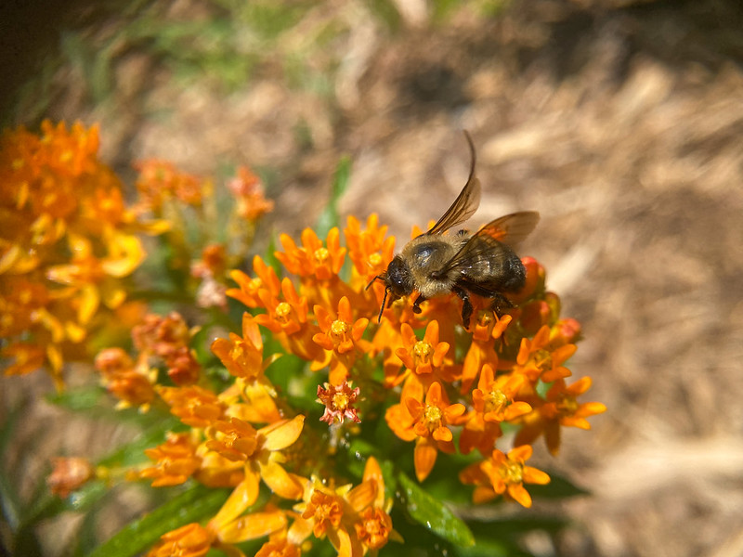
Pollinator Slope: After
Pollinator Slope:
After
Photo credit: MWMO

Slide 28
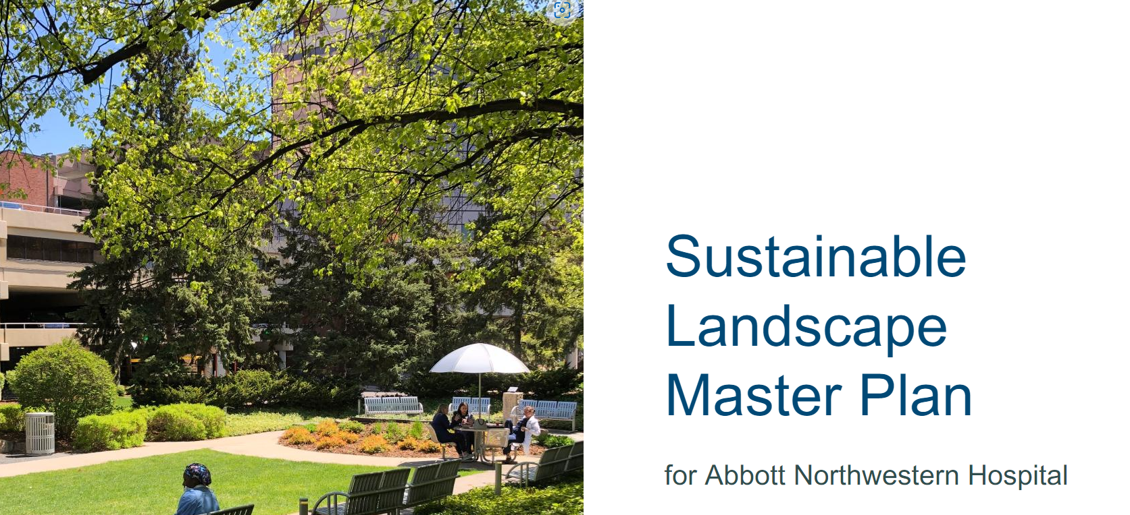
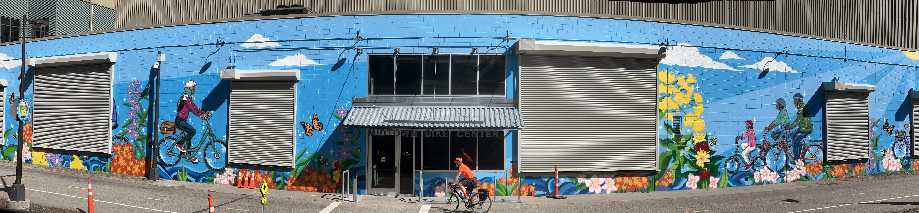
Project Benefits
Inspired Abbott Northwestern Sustainable Landscape Master Plan
  Stormwater climate resilience study
Influenced design of mural
Engages staff and public
Notes:
https://storymaps.arcgis.com/stories/e70fca1e45d04772b09a7a4a95e535d7

Slide 29
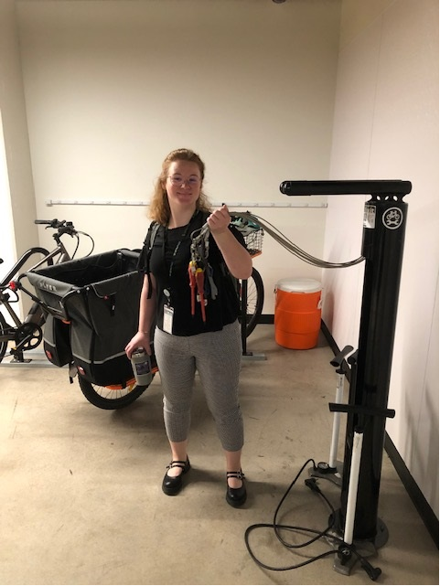
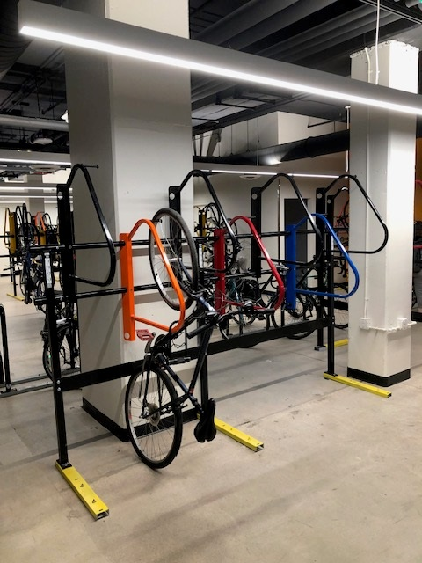
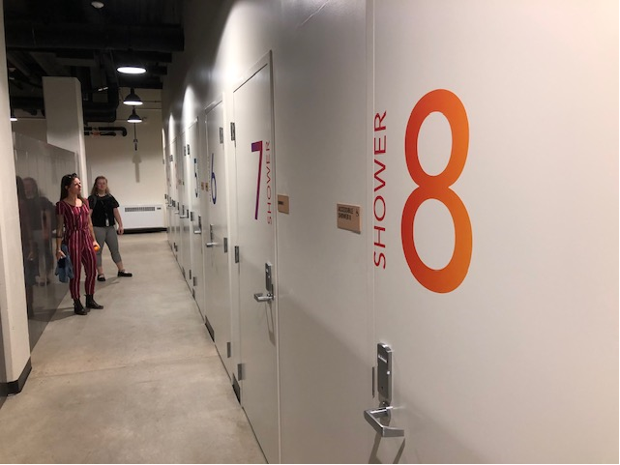
Bike center
Bike Center sized for 200 bikes
Showers/lockers
Fix it station
Bikewash
Bike shop
Coffee
Notes:
Source image: https://www.power-grid.com/der-grid-edge/minnesota-electric-car-drivers-will-see-22-new-places-to-fast-charge-this-fall/#gref

Slide 30
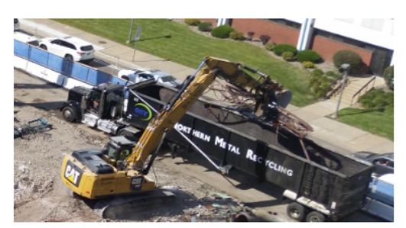
Construction & Demolition Waste
86% Construction and Demolition Waste Recycling
1176 tons recycled
Notes:
March –Aug 2021 recycling data. Better than Practice Greenhealth best practices 80%

Slide 31
Questions?

